Slide 1
Knowledge Modeling and Knowledge Management
Lecture 1 - Overview of Knowledge Modeling and Management
Prof. Li Yao

Slide 2
Topics
Introduction
Current Perspectives
Motivations of Knowledge Modeling
Relationships to Information Systems and Other Disciplines
The History of Knowledge Engineering and Knowledge Management

Slide 3
Topics
Introduction
Current Perspectives
Motivations of Knowledge Modeling
Relationships to Information Systems and Other Disciplines
The History of Knowledge Engineering and Knowledge Management

Slide 4
Introduction
What is “knowledge management”?
    Knowledge
    knowing process
    Knowledge Management
    What is “knowledge engineering” ?
    Knowledge representation
    Automated Reasoning
    Engineering techniques

Slide 5
Understanding KM
Understanding Knowledge Management requires an understanding of knowledge and the knowing process and how that differs from information and information management.

Slide 6
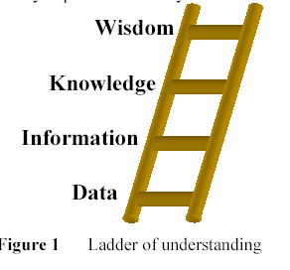
Classic Data to Knowledge Hierarchy
Notes:
used in the librarian community

Slide 7
Data
Data is a perception, a signal, a sign or a quantum of interaction (e.g. '40' or 'T' are data).
Data is symbolic representation of numbers, fact, quantities; an item of data is what a natural or artificial sensor indicates about a variable. [Weggeman, 1996].
Data are made up of symbols and figures which reflect a perception of the experiential world [Fukuda, 1995].

Slide 8
Information
Information is data structured according to a convention . [Fabien Gandon,2002]
  e.g. T=40°.
Information is the result of the comparison of data which are situationally structured in order to arrive at a message that is significant in a given context [Weggeman, 1996].
Information is obtained from data which have been given a significance and selected as useful [Fukuda, 1995].

Slide 9
Knowledge
Knowledge is information with a context and value that make it usable. [Fabien Gandon,2002]
  e.g. "the patient of the room 313 of the Hospital of Orleans has a temperature T=40°“
Knowledge is what places someone in the position to perform a particular task by selecting, interpreting and evaluation information depending on the context. [Weggeman, 1996]
Knowledge is an information which was interpreted in context and which meaning was articulated with already acquired knowledge [Fukuda, 1995].
Notes:
This is why knowledge empowers people.
Knowledge is systematised information which I understand as the information being arranged according to a definite plan or scheme i.e., existing knowledge.

Slide 10
Wisdom
Wisdom can be defined as timeless knowledge. [Fabien Gandon,2002]
An intermediary step for theory as generalized knowledge. [Fukuda, 1995]

Slide 11
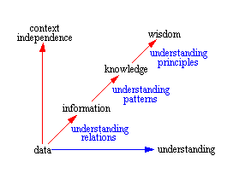
Relationship
Notes:
Before attempting to address the question of knowledge management, it's probably appropriate to develop some perspective regarding this stuff called knowledge, which there seems to be such a desire to manage, really is. Consider this observation made by Neil Fleming[fle96] as a basis for thought relating to the following diagram.
A collection of data is not information.
A collection of information is not knowledge.
A collection of knowledge is not wisdom.
A collection of wisdom is not truth.
The idea is that information, knowledge, and wisdom are more than simply collections. Rather, the whole represents more than the sum of its parts and has a synergy of its own.
We begin with data, which is just a meaningless point in space and time, without reference to either space or time. It is like an event out of context, a letter out of context, a word out of context. The key concept here being "out of context." And, since it is out of context, it is without a meaningful relation to anything else. When we encounter a piece of data, if it gets our attention at all, our first action is usually to attempt to find a way to attribute meaning to it. We do this by associating it with other things. If I see the number 5, I can immediately associate it with cardinal numbers and relate it to being greater than 4 and less than 6, whether this was implied by this particular instance or not. If I see a single word, such as "time," there is a tendency to immediately form associations with previous contexts within which I have found "time" to be meaningful. This might be, "being on time," "a stitch in time saves nine," "time never stops," etc. The implication here is that when there is no context, there is little or no meaning. So, we create context but, more often than not, that context is somewhat akin to conjecture, yet it fabricates meaning.
That a collection of data is not information, as Neil indicated, implies that a collection of data for which there is no relation between the pieces of data is not information. The pieces of data may represent information, yet whether or not it is information depends on the understanding of the one perceiving the data. I would also tend to say that it depends on the knowledge of the interpreter, but I'm probably getting ahead of myself, since I haven't defined knowledge. What I will say at this point is that the extent of my understanding of the collection of data is dependent on the associations I am able to discern within the collection. And, the associations I am able to discern are dependent on all the associations I have ever been able to realize in the past. Information is quite simply an understanding of the relationships between pieces of data, or between pieces of data and other information.
While information entails an understanding of the relations between data, it generally does not provide a foundation for why the data is what it is, nor an indication as to how the data is likely to change over time. Information has a tendency to be relatively static in time and linear in nature. Information is a relationship between data and, quite simply, is what it is, with great dependence on context for its meaning and with little implication for the future.
Beyond relation there is pattern[bat88], where pattern is more than simply a relation of relations. Pattern embodies both a consistency and completeness of relations which, to an extent, creates its own context. Pattern also serves as an Archetype[sen90] with both an implied repeatability and predictability.
When a pattern relation exists amidst the data and information, the pattern has the potential to represent knowledge. It only becomes knowledge, however, when one is able to realize and understand the patterns and their implications. The patterns representing knowledge have a tendency to be more self-contextualizing. That is, the pattern tends, to a great extent, to create its own context rather than being context dependent to the same extent that information is. A pattern which represents knowledge also provides, when the pattern is understood, a high level of reliability or predictability as to how the pattern will evolve over time, for patterns are seldom static. Patterns which represent knowledge have a completeness to them that information simply does not contain.
Wisdom arises when one understands the foundational principles responsible for the patterns representing knowledge being what they are. And wisdom, even more so than knowledge, tends to create its own context. I have a preference for referring to these foundational principles as eternal truths, yet I find people have a tendency to be somewhat uncomfortable with this labeling. These foundational principles are universal and completely context independent. Of course, this last statement is sort of a redundant word game, for if the principle was context dependent, then it couldn't be universally true now could it?
So, in summary the following associations can reasonably be made:
Information relates to description, definition, or perspective (what, who, when, where).
Knowledge comprises strategy, practice, method, or approach (how).
Wisdom embodies principle, insight, moral, or archetype (why).
Now that I have categories I can get hold of, maybe I can figure out what can be managed.
An Example
This example uses a bank savings account to show how data, information, knowledge, and wisdom relate to principal, interest rate, and interest.
Data: The numbers 100 or 5%, completely out of context, are just pieces of data. Interest, principal, and interest rate, out of context, are not much more than data as each has multiple meanings which are context dependent.
Information: If I establish a bank savings account as the basis for context, then interest, principal, and interest rate become meaningful in that context with specific interpretations.
Principal is the amount of money, $100, in the savings account.
Interest rate, 5%, is the factor used by the bank to compute interest on the principal.
Knowledge: If I put $100 in my savings account, and the bank pays 5% interest yearly, then at the end of one year the bank will compute the interest of $5 and add it to my principal and I will have $105 in the bank. This pattern represents knowledge, which, when I understand it, allows me to understand how the pattern will evolve over time and the results it will produce. In understanding the pattern, I know, and what I know is knowledge. If I deposit more money in my account, I will earn more interest, while if I withdraw money from my account, I will earn less interest.
Wisdom: Getting wisdom out of this is a bit tricky, and is, in fact, founded in systems principles. The principle is that any action which produces a result which encourages more of the same action produces an emergent characteristic called growth. And, nothing grows forever for sooner or later growth runs into limits.
If one studied all the individual components of this pattern, which represents knowledge, they would never discover the emergent characteristic of growth. Only when the pattern connects, interacts, and evolves over time, does the principle exhibit the characteristic of growth.
Note: If the mechanics of this diagram are unfamiliar, you can find the basis in Systems Thinking Introduction[bel96] .
Now, if this knowledge is valid, why doesn't everyone simply become rich by putting money in a savings account and letting it grow? The answer has to do with the fact that the pattern described above is only a small part of a more elaborate pattern which operates over time. People don't get rich because they either don't put money in a savings account in the first place, or when they do, in time, they find things they need or want more than being rich, so they withdraw money. Withdrawing money depletes the principal and subsequently the interest they earn on that principal. Getting into this any deeper is more of a systems thinking exercise than is appropriate to pursue here.

Slide 12
An Example
This example uses a bank savings account to show how data, information, knowledge, and wisdom relate to principal, interest rate, and interest.
Data: The numbers 100 or 5%, completely out of context, are just pieces of data. Interest, principal, and interest rate, out of context, are not much more than data as each has multiple meanings which are context dependent.
Information: If I establish a bank savings account as the basis for context, then interest, principal, and interest rate become meaningful in that context with specific interpretations.
  Principal is the amount of money, $100, in the savings account.
  Interest rate, 5%, is the factor used by the bank to compute interest on the principal.

Slide 13
An Example (Cont.)
Knowledge: If I put $100 in my savings account, and the bank pays 5% interest yearly, then at the end of one year the bank will compute the interest of $5 and add it to my principal and I will have $105 in the bank. This pattern represents knowledge, which, when I understand it, allows me to understand how the pattern will evolve over time and the results it will produce. In understanding the pattern, I know, and what I know is knowledge. If I deposit more money in my account, I will earn more interest, while if I withdraw money from my account, I will earn less interest.
Wisdom: Getting wisdom out of this is a bit tricky, and is, in fact, founded in systems principles. The principle is that any action which produces a result which encourages more of the same action produces an emergent characteristic called growth. And, nothing grows forever for sooner or later growth runs into limits.

Slide 14
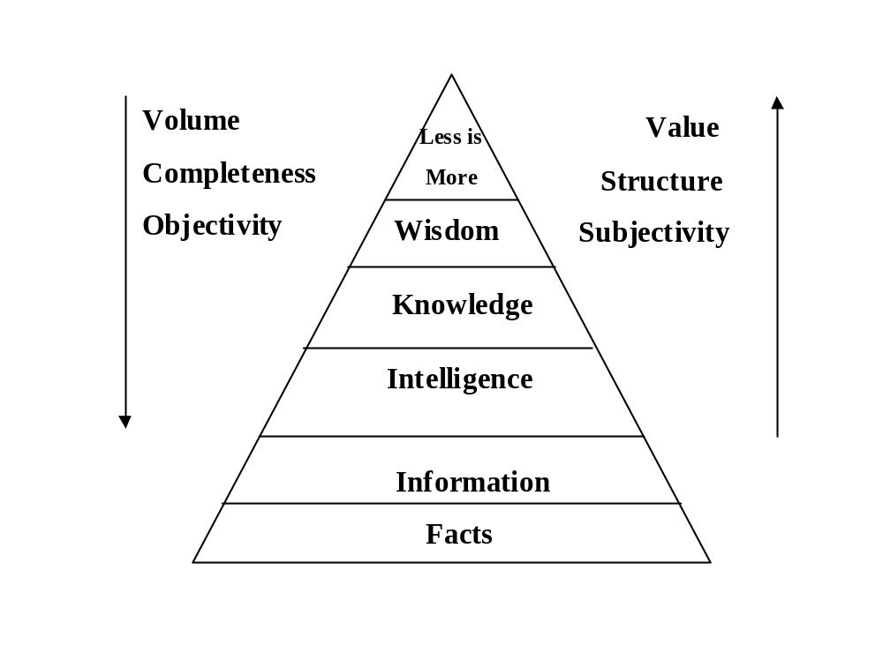
From Facts to Wisdom
Haeckel & Nolan( 1993)
one example of the hierarchy

Slide 15
What is knowledge management?
“Knowledge management (KM) is an effort to increase useful knowledge within the organization. Ways to do this include encouraging communication, offering opportunities to learn, and promoting the sharing of appropriate knowledge artifacts.”
McInerney, C. (2002). Knowledge management and the dynamic nature of knowledge. JASIST, 53 (2).
Notes:
An informal survey conducted by the author identified over 100 published
definitions of knowledge management, and of these, at least 72 could be considered
very good!

Slide 16
Topics
Introduction
Current Perspectives
Motivations of Knowledge Modeling
Relationships to Information Systems and Other Disciplines
The History of Knowledge Engineering and Knowledge Management

Slide 17
Knowledge management from the business perspective
Knowledge management is a collaborative and integrated approach to the creation, capture, organization, access and use of an enterprise’s intellectual assets. (Grey, 1996)
Treating the knowledge component of business activities as an explicit concern of business reflected in strategy, policy, and practice at all levels of the organization; and, making a direct connection between an organization’s intellectual assets—both explicit (recorded) and tacit (personal know-how)—and positive business results. (Barclay and Murray, 1997)

Slide 18
Knowledge management from the cognitive science or knowledge science perspective
Knowledge—the insights, understandings, and practical know-how that we all possess—is the fundamental resource that allows us to function intelligently.
Over time, considerable knowledge is also transformed to other manifestations—such as books, technology, practices, and traditions—within organizations of all kinds and in society in general. These transformations result in cumulated [sic] expertise and, when used appropriately, increased effectiveness. Knowledge is one, if not THE, principal factor that makes personal, organizational, and societal intelligent behavior possible. (Wiig, 1993, pp. 38–39)

Slide 19
KM from Technology Perspectives
A systematic approach to manage the use of information in order to provide a continuous flow of Knowledge to the right people at the right time enabling efficient and effective decision making in their everyday business. (Steve Ward)
Knowledge management is the concept under which information is turned into actionable knowledge and made available effortlessly in a usable form to the people who can apply it. (Information Week, Sept. 1, 2003)

Slide 20
Current perspective
Knowledge Management may be viewed in terms of:
People – how do you increase the ability of an individual in the organization to influence others with their knowledge
Processes – Its approach varies from organization to organization. There is no limit on the number of processes
Technology – It needs to be chosen only after all the requirements of a knowledge management initiative have been established.
Organizational Structure-Organizations need to put knowledge enablers in place that will stimulate the development of individual knowledge, group sharing of knowledge, and organizational retention of valuable knowledge-based content.

Slide 21
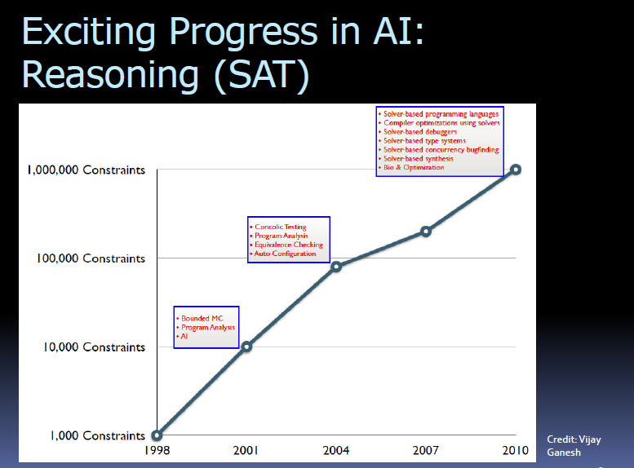

Exciting Progress in Technology

Slide 22
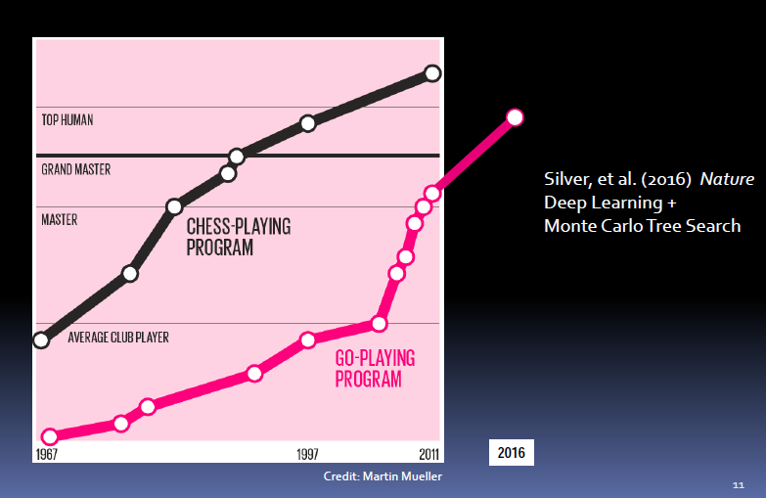
Exciting Progress in Technology

Slide 23
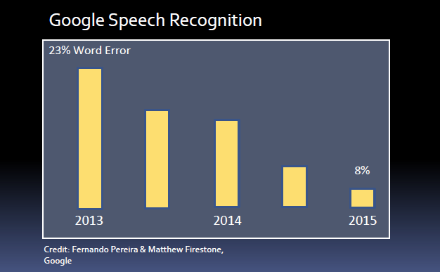
Exciting Progress in Technology

Slide 24
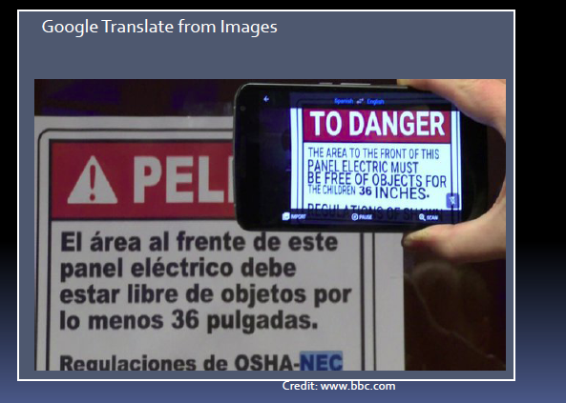
Exciting Progress in Technology

Slide 25
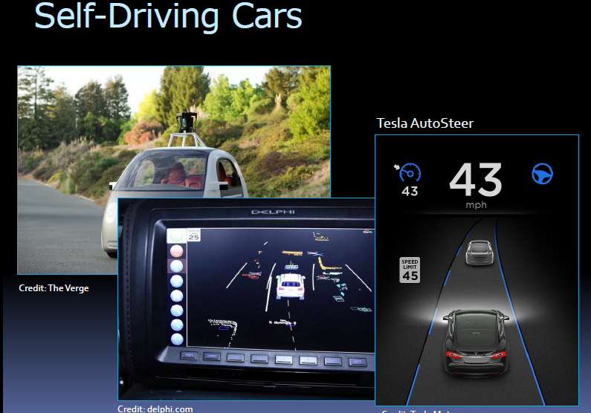
Exciting Progress in Technology

Slide 26
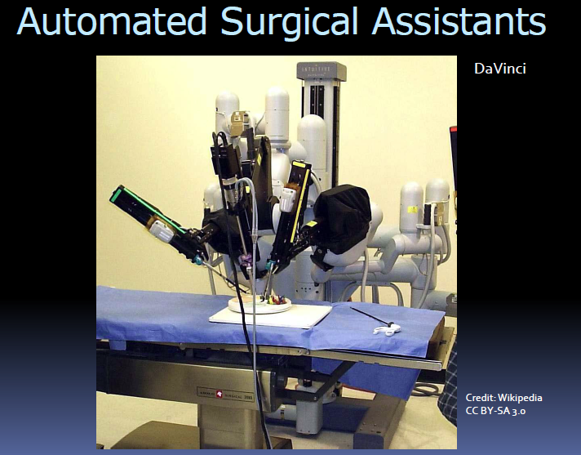
Exciting Progress in Technology

Slide 27
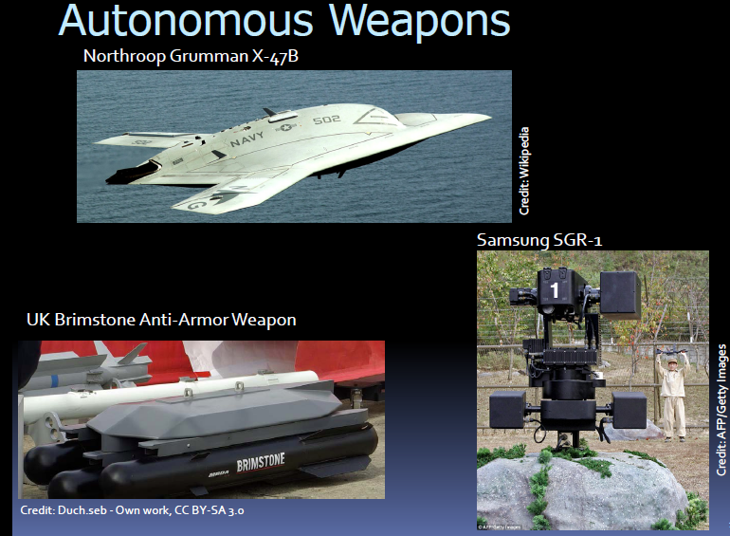
Exciting Progress in Technology

Slide 28
Exciting Progress in Technology
2015年开始，阿里巴巴在手机淘宝客户端推出了新一代智能客服产品——阿里小蜜，基于语音识别、语义理解、个性化推荐、深度学习等人工智能技术的应用。在每天应对百万级服务量的情况下，智能解决率达到了接近80%（该指标高于行业智能客服产品平均水平60%以上），甚至在部分重点场景上已经达到95%的智能解决率，服务领域里人机对话语义意图的精确匹配率提升到了93%，满意度比传统的自助服务提升了一倍。

Slide 29
Concluding Remarks
路涌祥：
人工智能在生产领域的应用，为新时代的产业结构升级变革提供了新机遇。在这万物互联的时代，人工智能以增强机器智力的方式替代人或与人协同工作，促进网络智能设计制造与服务，将大幅提升劳动生产率，重塑产业链与价值创造和分配方式。

Slide 30
What can we do ?
Knowledge management is the deliberate and systematic coordination of an organization’s people, technology, processes, and organizational structure in order to add value through reuse and innovation.
This coordination is achieved through creating, sharing, and applying knowledge as well as through feeding the valuable lessons learned and best practices into corporate memory in order to foster continued organizational learning.

Slide 31
Key Attributes of Knowledge Management
Generating new knowledge.
Accessing valuable knowledge from outside sources.
Using accessible knowledge in decision making.
Embedding knowledge in processes, products, and/or services.
Representing knowledge in documents, databases, and software.
Facilitating knowledge growth through culture and incentives.
Transferring existing knowledge into other parts of the organization.
Measuring the value of knowledge assets and/or impact of knowledge management.

Slide 32
Topics
Introduction
Current Perspectives
Motivations of Knowledge Modeling
Relationships to Information Systems and Other Disciplines
The History of Knowledge Engineering and Knowledge Management

Slide 33
Knowledge modeling
Knowledge modeling is intended for anyone whose job to analyze knowledge about the real world and map it to a computable form.
  Vocabulary + Fact Axioms+ Terminological Axioms
  Knowledge sharing and automated problem solving

Slide 34




Case 1: NASA Knowledge Hub
Ontology Architecture
  Enterprise-wide, Lifecycle-wide, “Incremental and Iterative”
Ontology Models
  Model-based support of engineering activities - multi-discipline
Build Semantic Engine Infrastructure
Needs you to
  start learning, start thinking “federated”, deploy early and often
From Ralph Hodgson
NASA
Knowledge
sources
Knowledge Advisor
Space Engineering Ontologies
Profiles
NASA Knowledge Hub
TAIR
KSC PRACA
JSC PRACA
GFE PRACA
SDS
EO
SEDS
JEEVES
MRCS
CVAS
CV

Slide 35
Knowledge Architecture
Knowledge Architecture focus on knowledge modeling and ontology development.
Knowledge modeling explores various strategic models for organizing KBS, with a focus on data and knowledge representation
Ontologies provided a shared and common understanding of some domain that can be communication across people and computers.

Slide 36

NASA Ontologies
Ontology | Description | Example concepts
nasa_core | Common root concepts across all of NASA | Artifact, Activity, Document, Initiative, Mission, Organization, Technology, Vehicle
nasa_ea | Enterprise architecture concepts | Enterprise, Governance, Process, Role, Task, Workproduct
nasa_system | System concepts | System, Component, Capability, Function, Behavior, Intent
nasa_technology | Specific technologies of interest to NASA | Software Technology, Propulsion, Power, Thermal Protection, Life Support Technology
nasa_discipline | Nasa disciplines | Electrical Engineering, Mechanical Engineering, Space Engineering, Thermal Dynamics, …
nasa_sba | Simulation-based acquisition | Cost, Performance, RFI, RFP, Risk, Tradeoff
… | … | …
From Ralph Hodgson

Slide 37
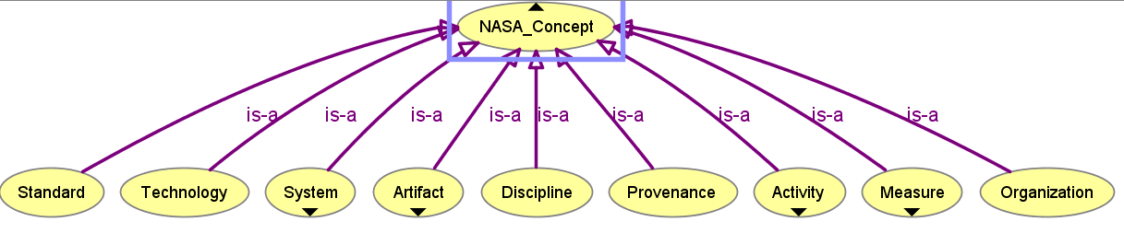
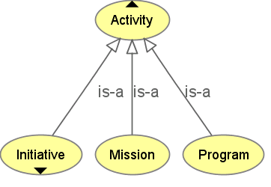
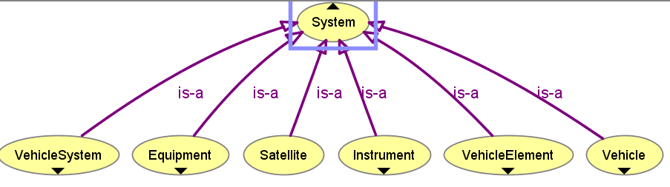
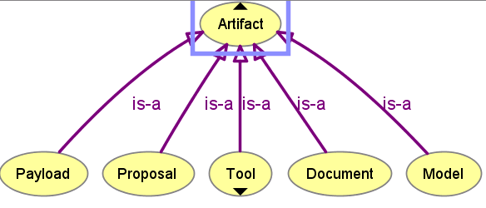
NASA CORE – common foundation
From Ralph Hodgson

Slide 38
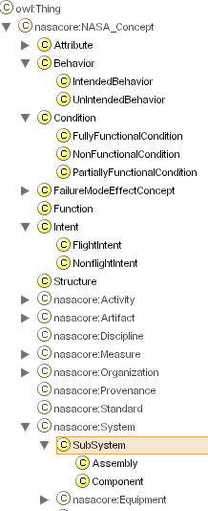
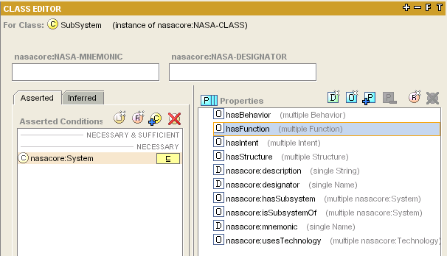
NASA System Ontology
SBF(I) model –
System has structure, behavior, function and intent
From Ralph Hodgson

Slide 39
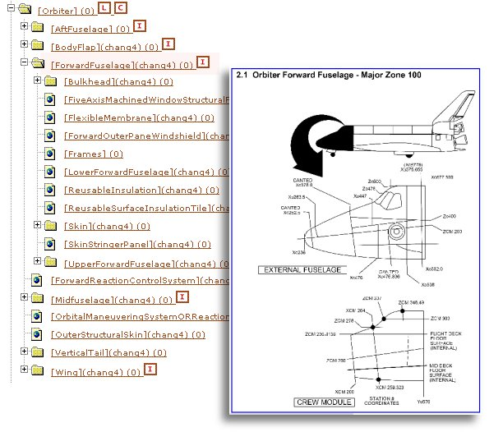
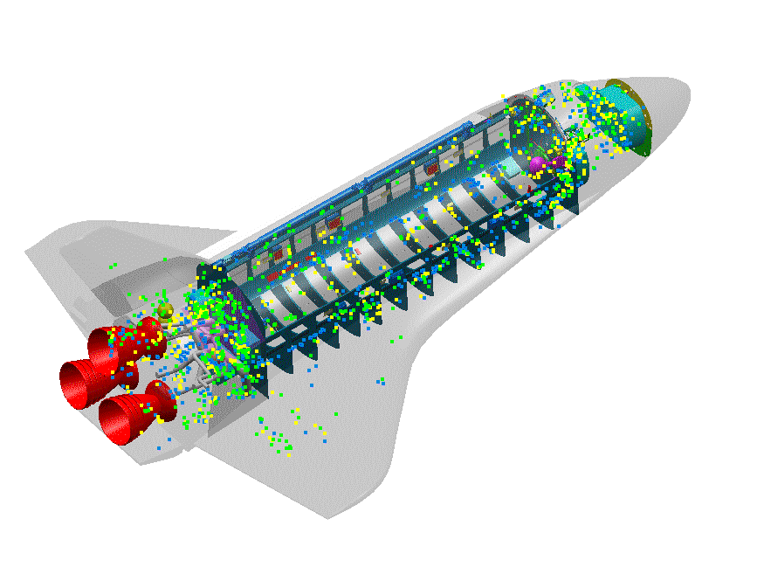
Example of Space Shuttle Ontology
From Ralph Hodgson

Slide 40
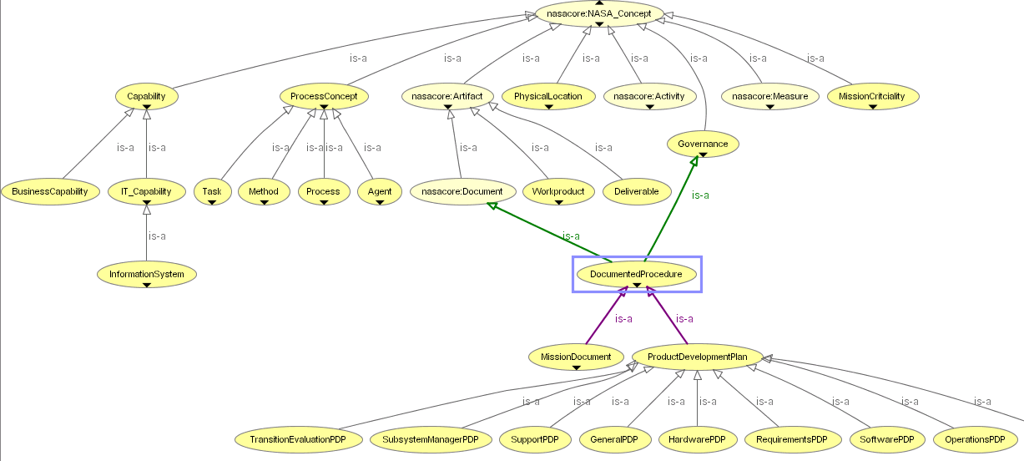
NASA Enterprise Ontology
Document-Centric ➔ Knowledge-Centric
From Ralph Hodgson

Slide 41
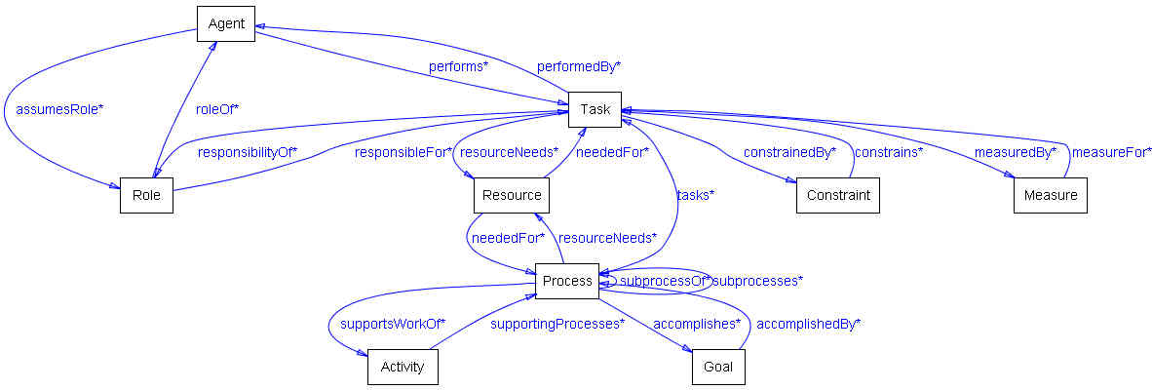
Some associations in the NASA Enterprise Architecture Process Ontology
Agent
Task
Role
Measure
Process
Goal
From Ralph Hodgson

Slide 42
Case 2: On-To-Knowledge
Ontologies will allow structural and semantic definitions of documents providing completely new possibilities compared with existing document management systems:
  Intelligent search instead of keyword matching.
  Query answering instead of information retrieval.
  Document exchange between departments via transformation operators.
  Definition of views on documents.
  Support of information maintenance.
Notes:
Large Intranets: Swiss Life
Customer Relationship Management: BT
Virtual Enterprise: Enersearch
A general Methodology: AIFB

Slide 43
Case 2: On-To-Knowledge
The goal of the On-To-Knowledge project is to support efficient and effective knowledge management. It focuses on acquiring, representing, and accessing weakly-structured on-line information sources:
  Acquiring: Text mining and extraction techniques are applied to extract semantic information from textual information.
  Representing: XML, RDF, and OIL are used for describing syntax and semantics of semi-structured information sources.
  Accessing: Novel semantic web search technology and knowledge sharing facilities.

Slide 44
On-To-Knowledge： The overall architecture and language
The On-To-Knowledge tool suite consists of:
  an Ontology-based knowledge sharing facility;
  an Ontology-based presentation platform;
  an Ontology-based search engine;
  an Ontology editor and semi-automatic Ontology construction tools;
  inference engines and query engine for meta data and schema information;
  persistent storage of Ontologies and meta data; and
  extraction tools for meta data.
User
Expert
Backbone

Slide 45
On-To-Knowledge： The overall architecture and language
OntoShare
User
RQL
RDF Ferret
Spectacle
Knowledge
Engineer
OIL-Core
OntoEdit
OMR
Pronto
Sesame
OIL-Core ontology repository
Annotated Data Repository
RDF
RDF
pers05
tel
731
par05
about
car
OntoWrapper
OntoExtract
Data
Repository
(external)
Τηισ τεξτ ισ
αβουτ χαρσ
εϖεν τηουγη
ψου χαν’τ
ρεαδ ιτ

Slide 46
Case 3: the Joint C3 Information Exchange Data Model
联合咨询、指挥和控制信息交换数据模型（JC3IEDM）是北约组织成员针对咨询、指挥和控制（Consultation, Command and Control ，C3）的信息交换而建立的数据模型，目前已采用国际标准语言OWL-DL进行了形式化建模。
JC3IEDM的前身是C2IEDM（Command and Control Information Exchange Data Model），已经开发了20多年。

Slide 47
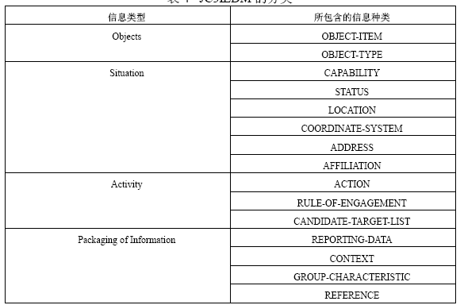
JC3IEDM的分类
JC3IEDM定义的对象包括人员、单位、物资、设施和要素。C2IEDM证明了这五个子类型涵盖了整个战场空间的所有对象。
态势就是关于对象的信息，包括对象之间的关系，对象之间的隶属关系，对象所具有的能力、状态、位置和地址等。
主要描述战场空间的行为和事件，即围绕对象在过去、现在或将来发生的活动，详细内容包括计划、执行、观测、事件的报告等。
把数据分组为信息包的形式进行描述和使用。绝大多数的动态数据是用信息包的形式来表现的。

Slide 48
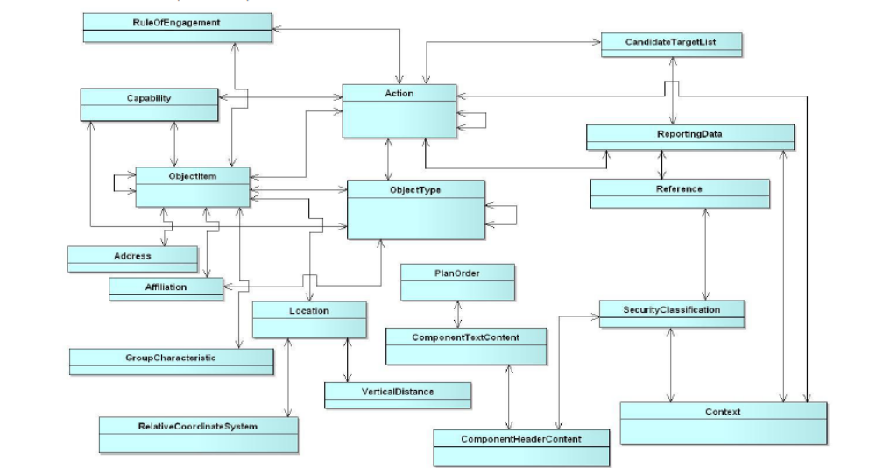
JC3IEDM的主要概念和关系
JC3IEDM含有大约300信息种类，描述了战场空间中所有的对象现象、事件、活动、状态、关系等信息；4500条与领域相关的规则用于描述数据元素之间的关系，其中包括与军事作战领域相关的规则，如机动、火力支援、防空、以及反恐特别作战等等。

Slide 49
Situation Theory Ontology
态势理论本体STO（Situation Theory Ontology）是由美国东北大学（Northeastern University）开发的一个关于态势理论的本体，并用OWL-DL进行了形式表示，STO可用于开发态势感知系统（Situation Awareness system，SAW）。
  “对象（Object）”类是STO的核心概念，STO的核心本体将对象类分为“抽象对象(AbstractObject)”和“物理对象(PhysicalObject)”。每一对象都用一些属性来刻画，例如，“容积（Volume）”、“位置（Position）”、“速度（Velocity）”、“重量（Weight）”、“颜色（Color）”等等，要求物理对象必须包括容积、位置、速度（Velocity）三个基本属性。
  目标可分为静态目标和动态目标，而动态目标随时间而变化，因此，目标识别知识表示最富挑战性的问题在于表示那些随时间不断演化的属性和关系。

Slide 50
Case 4： A Space Surveillance Ontology
The United States Air Force (USAF)
Joint Battlespace Infosphere [JBI]
it focuses on aspects related to space satellite catalog maintenance. This includes the development and distribution of satellite element sets (elsets), the receipt and processing of satellite observations used to maintain the satellite catalog, and tasking sent to ground-based sensors to collect observations to support satellite catalog maintenance.

Slide 51
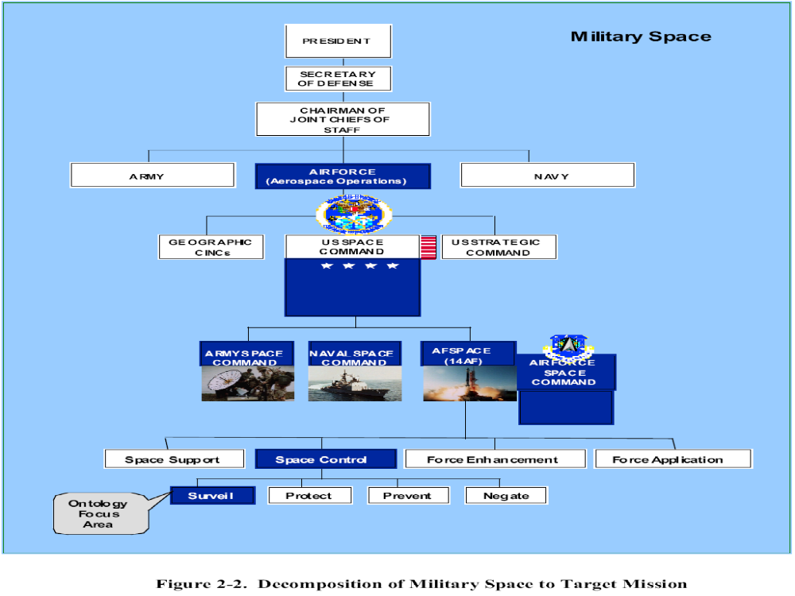

Slide 52
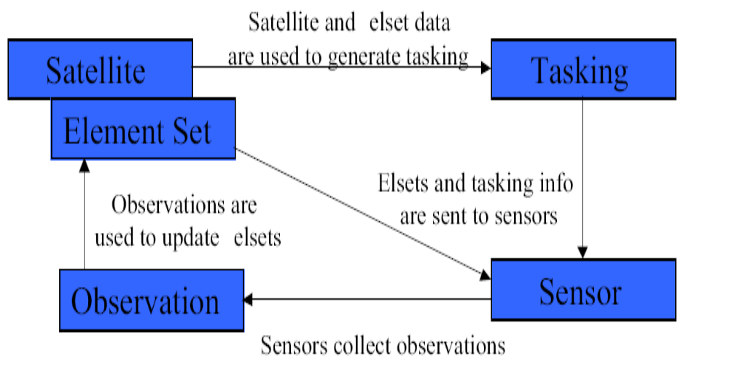
Major Elements and Their Interrelationships

Slide 53
CLASSIFICATION SCHEME FOR ARTIFICIAL SPACE OBJECTS
University of New Mexico / Air Force Research Laboratory
An ancestral-dynamic hierarchical tree based on a priori knowledge is established, motivated by taxonomy schemes used in biology.
Available orbital element data has been clustered.

Slide 54
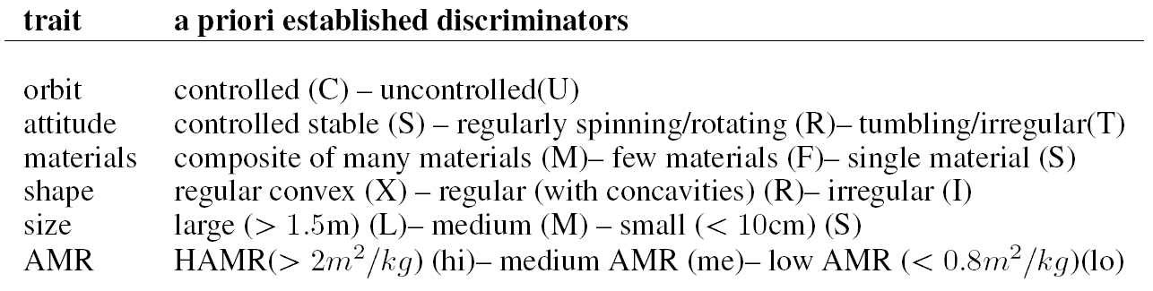
Key Physical Characteristics

Slide 55
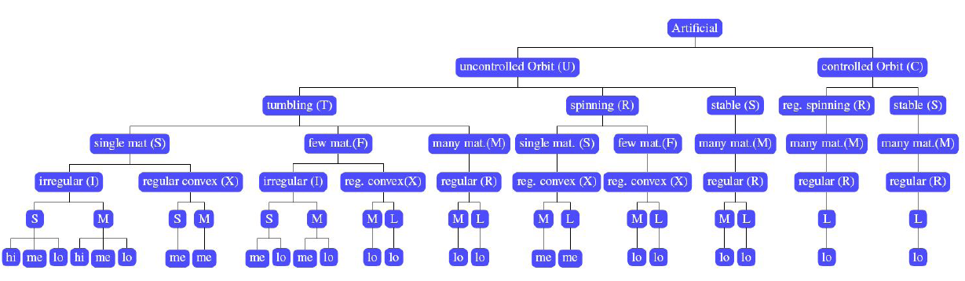
Classes based on key characteristics

Slide 56
An Artificial Space Object Taxonomy
Applied Defense Solutions/Air Force Research Laboratory
Object recognition/Object identification.
tree-based taxonomies delineate unique signatures by defining the minimum amount of information required to positively identify a RSO.

Slide 57
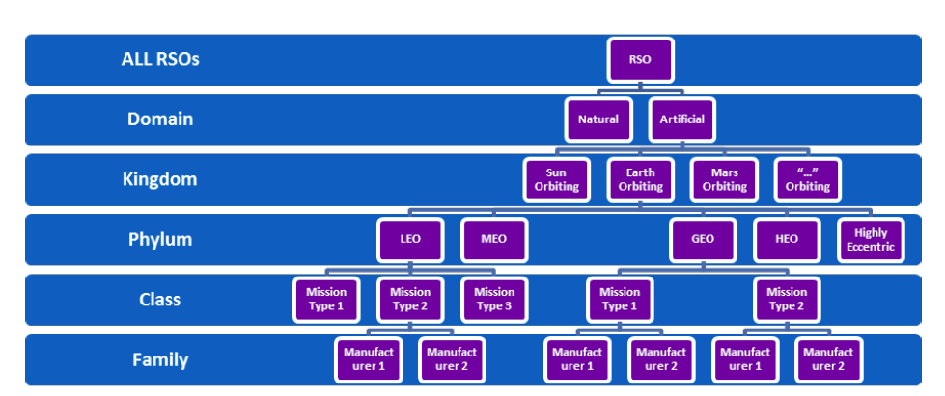
RSO Taxonomy for Artificial Objects
林奈分类体系：界-门-纲-目-属-种

Slide 58
Case 5：Organizational memory and learning
Organizational memory extends and amplifies knowledge as the key asset of the knowledge organization by capturing, organizing, disseminating, and reusing the knowledge created by its employees.
Organizational Learning：A process involved in human interaction, knowledge claim formulation, and validation by which new organizational knowledge is created;

Slide 59



Organizational memory and learning (1)
[Fabien Gandon, 2002]
Corporate Memory
Multi-Agents System
Learning
Learning
Learning
Interconnection
Agent
User
Agent
Ontology and Models Agent
Profile
Agent
User
Agent
Ontology
Knowledge
Engineer
Models
- Corporate Model
- User's Profiles

Slide 60












Organizational memory and learning (2)
[Fabien Gandon, 2002]
Corporate Memory
Annotation
Document
Authors and
annotators of documents
Multi-Agents System
Learning
Learning
Learning
Interconnection
Agent
User
Agent
Ontology and Models Agent
Profile
Agent
User
Agent

Slide 61



Organizational memory and learning (3)
[Fabien Gandon, 2002]
Corporate Memory
Multi-Agents System
Learning
Learning
Learning
Interconnection
Agent
User
Agent
Ontology and Models Agent
Profile
Agent
User
Agent
Query
Annotation
Annotation
Annotation
Document
Document
Document
End User

Slide 62



Organizational memory and learning (4)
[Fabien Gandon, 2002]
annotation
Corporate Memory
Annotation
Document
Authors and
annotators of documents
Multi-Agents System
Learning
Learning
Learning
Interconnection
Agent
User
Agent
Ontology and Models Agent
Profile
Agent
User
Agent
Ontology
Query
Annotation
Annotation
Knowledge
Engineer
Annotation
Document
Models
Document
Document
- Enterprise Model
- User's Profiles
End User
pull and push

Slide 63
Case 6：The Semantic Web
The idea behind the semantic web is to improve the usability of the web by providing more automated services and thereby helping the user to extract the information that she wants.
The semantic web deals with this problem through the use of ontologies, formal representations of the relationships between terms that enable them to be used in a consistent manner.
Notes:
Automated
extract

Slide 64
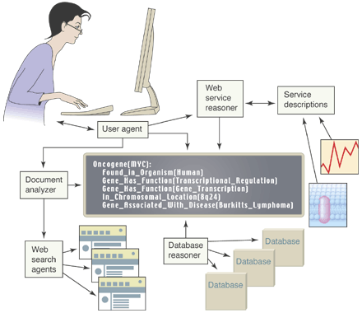
The Semantic Web
Shared ontologies help to exchange data and meaning between web-based services
(Image by Jim Hendler)
Notes:
data

Slide 65


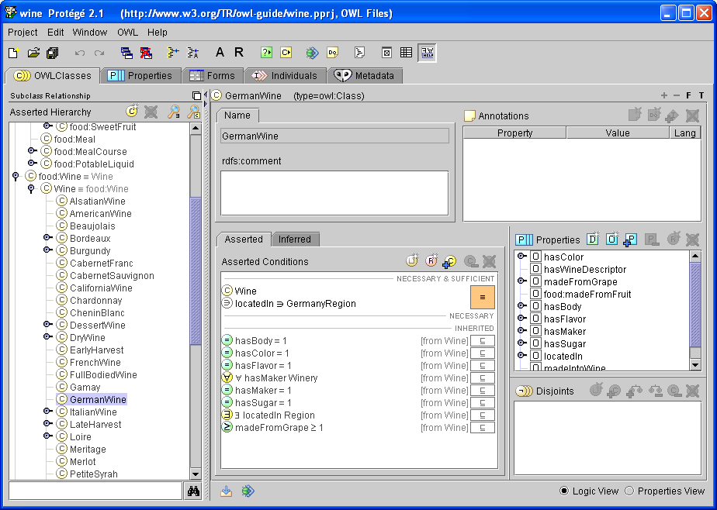

Wine Example Scenario
Tell me what wines I should buy to serve with each course of the following menu.
Books Agent
( Holger Knublauch)
Wine Agent
I recommend Chardonney or DryRiesling
Grocery Agent
Notes:
Recommend
Grocery

Slide 66
Topics
Introduction
Current Perspectives
Motivations of Knowledge Modeling
Relationships to Information Systems and Other Disciplines
The History of Knowledge Engineering and Knowledge Management

Slide 67
Relationships to information systems and other information disciplines
Cognitive science
Expert systems, artificial intelligence and knowledge base management systems (KBMS)
Computer-supported collaborative work (groupware)
Library and information science
Technical writing
Document management
Decision support systems
Semantic networks
Relational and object databases
Simulation
Organizational science
object-oriented information modeling
electronic publishing technology, hypertext, and the World Wide Web; help-desk technology
full-text search and retrieval
performance support systems

Slide 68
Technologies for KM
Intranets, portals
Groupware – email, conferencing
Repositories, hypermedia
  Taxonomies, ontologies
  Organizational memory support
Search, info retrieval, indexing
Data mining, knowledge discovery, text mining
Information integration
  from documents and databases

Slide 69
Knowledge orientation in Computing
Artificial intelligence – eg., semantic nets – since 70’s
    E.g., [Newell 1980] – “The Knowledge Level”
Databases – interoperability problem!
    E.g., [Sheth 98] - DB interoperability in GIS
The Semantic Web – the latest wave
    [Berners-Lee 01] – Sci. Am.
From Eric Yu

Slide 70
Why should IS professionals learn about KM?
Most KM initiatives presuppose technology support.
    We (IS people) are expected to provide it.
    Do we have the right methods and tools?
There has actually been a “Knowledge” movement within the IT/CS area for a long time, since the ’70s, long before it became a management “fad” in the business community.
    How do knowledge concepts in technology systems help us understand knowledge in human social systems?
IS work is itself knowledge-intensive.
    We should apply KM concepts to analyze and improve IS work – IS development, deployment, evolution, etc.
From Eric Yu

Slide 71
Topics
Introduction
Current Perspectives
Motivations of Knowledge Modeling
Relationships to Information Systems and Other Disciplines
The History of Knowledge Engineering and Knowledge Management

Slide 72
The History of Knowledge Management
1970's
Peter Drucker: information and knowledge as organizational resources
Peter Senge: "learning organization"
Leonard-Barton: well-known case study of "Chaparral Steel ", a company having knowledge management strategy
Notes:
A number of management theorists have contributed to the evolution of knowledge management

Slide 73
The History of Knowledge Management
1980's
Knowledge (and its expression in professional competence) as a competitive asset was apparent
Managing knowledge that relied on work done in artificial intelligence and expert systems
Knowledge management-related articles began appearing in journals and books

Slide 74
The History of Knowledge Management
1990's until now
A number of management consulting firms had begun in-house knowledge management programs
Knowledge management was introduced in the popular press, the most widely read work to date is Ikujiro Nonaka’s and Hirotaka Takeuchi’s The Knowledge-Creating Company: How Japanese Companies Create the Dynamics of Innovation (1995)
The International Knowledge Management Network (IKMN) went online in 1994
Knowledge management has become big business for such major international consulting firms as Ernst & Young, Arthur Andersen, and Booz-Allen & Hamilton

Slide 75
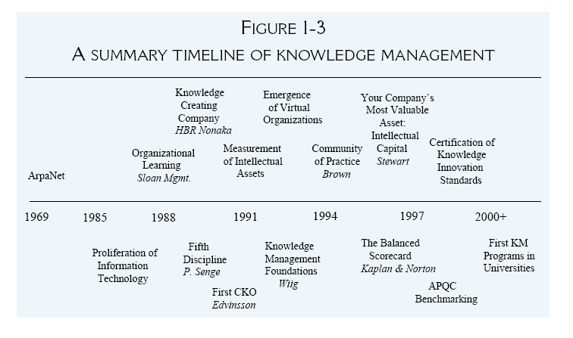
From Kimiz Dalkir

Slide 76
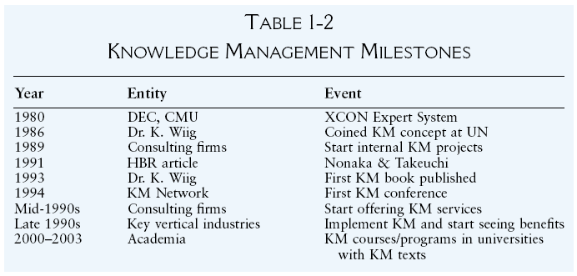
From Kimiz Dalkir

Slide 77
Three Generations of KM
The first generation (past)
  Knowledge sharing- Supply-side KM
  IT-driven
The second generation (present)
  Knowledge creation-Demand-side KM
  Focusing on socialization issues, including human and culture factors,
The third generation (future)
  Value creation
  Data mining and machine learning
  Artificial Intelligence

Slide 78
Value creation: the future of KM
It is necessary to explore and emphasize the impact of KM on people, organization, and society in terms of value creation. [Vorakulpipat & Rezgui 2006]
  Knowledge can be described as a source of value creation.
  KM processes have inherent value creation capabilities.
Knowledge infrastructure, knowledge architectures, and knowledge discovery are key areas.

Slide 79
KM research topics in future
What are the exact mechanisms by which knowledge and learning are institutionalized and embedded in the corporate memory?
How can communities of practice support and enhance professional education?
When do stories work best and why? Is there a best practice for creating and telling stories?
What drives employees to share their knowledge with each other or, conversely, to hoard it? What can management do to increase knowledge sharing among employees?
How can weblogs be used in KM research? What types of data can be collected, and how can they be analyzed?
Is there a gap between theory and implementation of knowledge management systems and principles?
From Kimiz Dalkir

